Slide 1
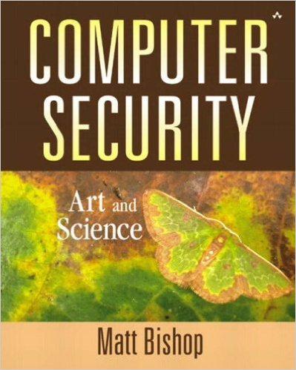
Computer and Network Security COMP 5370/637* Lecture #2 August 19, 2015
Tony Skjellum
skjellum@auburn.edu

Slide 2
Today’s Topics
Basics

Slide 3
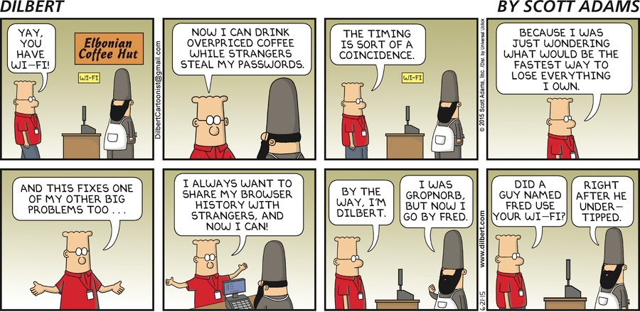
What is Cyber?
Opinions?
http://dilbert.com/search_results?terms=cyber+security

Slide 4
Security Threats
Disclosure
unauthorized access to information
Deception
acceptance of false data
Disruption
interruption or prevention of correct operation
Usurpation
unauthorized control of some part of a system
http://www.ietf.org/rfc/rfc2828.txt

Slide 5
Attack Vectors
People/IDs
Content
social engineering
Data
sematic tampering
rogue software
Media
tampering
sniffing
jamming
denial of service
Hardware
supply chain management
Cyberspace can be perceived as consisting of layers of abstraction, where each layer addresses a particular level of detail. Each layer has a distinct set of vulnerabilities.

Slide 6
Effect Vectors
policy, laws, regulation
Social
Logical
economic infrastructure
Physical
physical infrastructure
System
technical infrastructure
Similarly, the effects of a cyber attack can be viewed in layers of abstraction, ranging from disruptions in network communication to tangible resources (e.g., electricity generation, water distribution, etc.) to financial/services infrastructure to societal behavior.

Slide 7
Five Core Challenges
Only authorized parties can access information
Information transactions cannot take place without authorization or without detection
Information must be available when needed
Information transactions must be guaranteed to be authentic
No legitimate transaction can be renounced as illegitimate.
Information Assurance

Slide 8
Consider: True/False
Cyber conflict is new and changing?
Massive surprise attacks can easily subdue nations?
Cyber events happen at the speed of light?
Cyber attacks could cripple economies?
Wars will often involve cyber from now on?
Individual privacy is dead?

Slide 9
Heartbleed
The s in https stands for “secure”
https means that web traffic is encrypted using SSL
Heartbleed targets a particular implementation, OpenSSL
“back door” can be exploited to get unencrypted data
Notes:
Source: http://heartbleed.com/

Slide 10
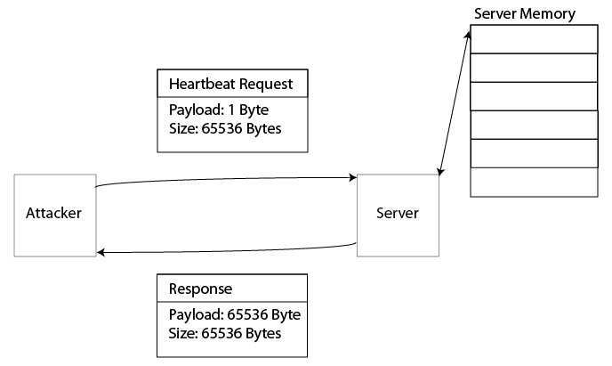
Mechanics
OpenSSL sends a message with no actual data at a given interval to keep connection active.
This "heartbeat" request includes payload and size of payload.
Attacker can send a 1 byte payload but specify size of 65536 Bytes.
Server copies payload to memory, uses as necessary, then copies back number of bytes specified.
There is no bounds checking. This means that the payload returned has 65535 Bytes of unencrypted data, which can include passwords and encryption keys.
Notes:
OpenSSL uses the heartbeat pattern – sends a message with no actual data at a given interval to keep connection active.
Heartbeat request includes payload and size of payload.
Attacker can send a 1 byte payload but specify size of 65536 Bytes.
Server copies payload to memory, uses as necessary, then copies back number of bytes specified. There is no bounds checking. This means that the payload returned has 65535 Bytes of unencrypted data, which can include passwords and encryption keys.
Source: http://www.youtube.com/watch?v=hTK0pywfmDE

Slide 11
Implications
Thousands of sites affected, including Facebook, Google, and LinkedIn
Could potentially release any data sent over the Internet
Requires patches or new protocol implementations, costing time and money
Clearly security has a large impact on computing!
Notes:
http://mashable.com/2014/04/09/heartbleed-bug-websites-affected/

Slide 12
Basic Functions of Security
Confidentiality
Integrity
Availability
How do these compare/contrast with the five tenets of IA?

Slide 13
Basic Functions of Security
Confidentiality
Integrity
Availability
Concept: data is not disclosed to unauthorized individuals, entities, or processes
Assumption: reliance on correct data
Via
encryption
access control mechanisms
hiding
http://www.ietf.org/rfc/rfc2828.txt
Notes:
How
encryption, hiding, access matrix

Slide 14
Basic Functions of Security
Concept: trustworthiness of the data
data integrity
data has not been changed, destroyed, or lost in an unauthorized or accidental manner
origin integrity
data comes from a credible source
Assumption: source of data and trust in source
Confidentiality
Integrity
Availability
http://www.ietf.org/rfc/rfc2828.txt
Notes:
How
encryption, hiding, access matrix

Slide 15
Basic Functions of Security
Confidentiality
Integrity
Availability
Via
prevention
block unauthorized attempts to change data
block changes that are not authorized
detection
identify loss of trust in data's integrity
http://www.ietf.org/rfc/rfc2828.txt
Notes:
How
encryption, hiding, access matrix

Slide 16
Basic Functions of Security
Confidentiality
Integrity
Availability
Concept: data is accessible and usable upon demand by an authorized system entity, according to performance specifications
Assumption: criticality, reliability, survivability characteristics are known and valid
Via
?
http://www.ietf.org/rfc/rfc2828.txt
Notes:
How
encryption, hiding, access matrix

Slide 17
Comparison?
Bishop
Information Assurance
Confidentiality
Integrity
Availability
Only authorized parties can access information
Information transactions cannot take place without authorization or without detection
Information must be available when needed
Information transactions must be guaranteed to be authentic
No legitimate transaction can be renounced as illegitimate.

Slide 18
Terminology
Threat
Attack
Policy
Mechanism
Assurance
Concept: Potential for violation of security, which exists when there is a circumstance, capability, action, or event that could breach security and cause harm.
Classes of threats
disclosure
deception
disruption
usurpation
http://www.ietf.org/rfc/rfc2828.txt
Notes:
How
encryption, hiding, access matrix

Slide 19
Terminology
Threat
Attack
Policy
Mechanism
Assurance
Threat Model
Attack motivation
malicious/rational
Attack membership
insider/outsider
Attack mobility
static/dynamic
Attack strategy
active/passive
Attack scope
local/extended
Notes:
How
encryption, hiding, access matrix

Slide 20
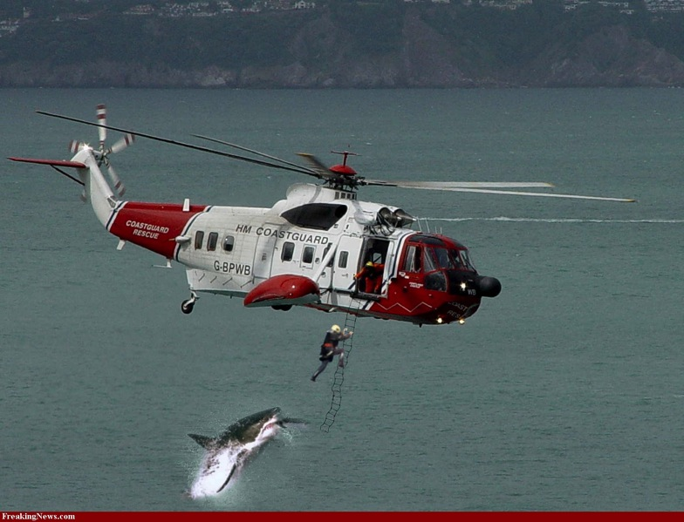
Terminology
Threat
Attack
Policy
Mechanism
Assurance
Concept: oops
Notes:
How
encryption, hiding, access matrix

Slide 21
Terminology
A statement of what is allowed and isn’t
Threat
Attack
Policy
Mechanism
Assurance
A method, tool, or procedure for enforcing policy
Let P be set of all possible states; Q be set of states that satisfy security policy. A security mechanism that restricts allowable states to R is …
secure if R is a subset of Q
precise if R = Q
broad if a state is in R, but not in Q
Notes:
How
encryption, hiding, access matrix

Slide 22
Terminology
Assumptions:
each mechanism implements one or more parts of a policy
the union of all mechanisms implements all the policy
mechanisms are implemented correctly
mechanisms are installed and administered correctly
Threat
Attack
Policy
Mechanism
Assurance
What complications can arise?
Notes:
How
encryption, hiding, access matrix

Slide 23
Terminology
Threat
Attack
Policy
Mechanism
Assurance
Goals are to define/implement:
prevention
detection
recovery
stop attack
repair
in-situ operations
post-attack
Notes:
How
encryption, hiding, access matrix

Slide 24
Terminology
Threat
Attack
Policy
Mechanism
Assurance
Concept: confidence that the system operates such that the system security policy is enforced.
Questions
are the desired security requirements specified?
does the design support the specifications?
does the implementation satisfy the design and the specs?
http://www.ietf.org/rfc/rfc2828.txt
Notes:
How
encryption, hiding, access matrix

Slide 25
Terminology
How do you "assure"?
Threat
Attack
Policy
Mechanism
Assurance
Concept: confidence that the system operates such that the system security policy is enforced.
Questions
are the desired security requirements specified?
does the design support the specifications?
does the implementation satisfy the design and the specs?
http://www.ietf.org/rfc/rfc2828.txt
Notes:
How
encryption, hiding, access matrix

Slide 26
Security Considerations
Cost vs benefit
Risk analysis
Risk = expectation of loss expressed as the probability that a particular threat will exploit a particular vulnerability with a particular harmful result. http://www.ietf.org/rfc/rfc2828.txt
Risk …
is a function of the environment
changes over time
may be acceptable, may not
may be difficult to quantify
Laws and Customs
legal vs acceptable may differ

Slide 27
Security Considerations
Organizational issues
motivation for security within organization
tangible vs intangible costs of security
e.g., opportunity loss, productivity loss
designating responsibility for security
scarcity of resources

Slide 28
Security Considerations
People issues
social engineering
insider misuse
Newbie or regular user mistakes
Misconfiguration
Ignorance or ignoring of rules

Slide 29
To Do
Read Auburn’s security policy
Come prepared to discuss AU's security mechanisms.
Learn about password vaults – adopt one
Learn about GPG/PGP, make your pub/private key pair
Make one
Keep the secret key a secret!
Use a strong password to protect access to it!
Add your key to your mail software if supported
Cf, https://www.gnupg.org/

Slide 30
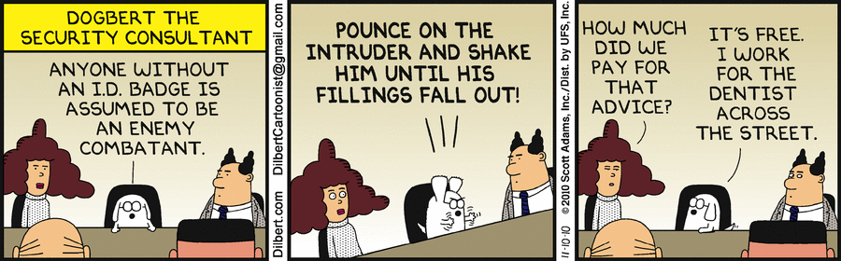
What is Cyber?
Opinions?
http://dilbert.com/search_results?terms=cyber+security

Slide 31
BACKUP

Slide 32
Demo
Short demo
http://www.youtube.com/watch?v=OMtvF-FTxGQ
Longer explanation
https://www.youtube.com/watch?v=hTK0pywfmDE

